Slide 1
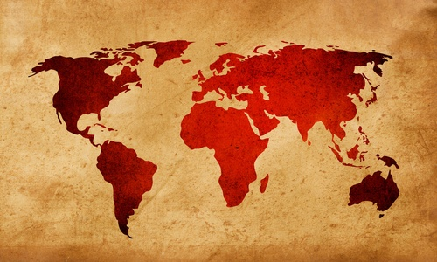
Foreign Policy Lesson 1 – “Conducting Foreign Relations”
1

Slide 2
Goals of U.S. Foreign Policy
With advancements in communication, trade, and technology, the nations of the world have become increasingly interdependent (reliant) on each other
These nations must cooperate on many issues to keep a balance of power in the world.
The plan that a country follows for interacting with other countries is called foreign policy.
2

Slide 3
Goals of U.S. Foreign Policy
Forming U.S. foreign policy is very complex. There are 5 main goals of U.S. foreign policy:
Maintaining national security
Supporting democracy
Promoting world peace
Providing aid to people in need
Establishing open trade
3

Slide 4
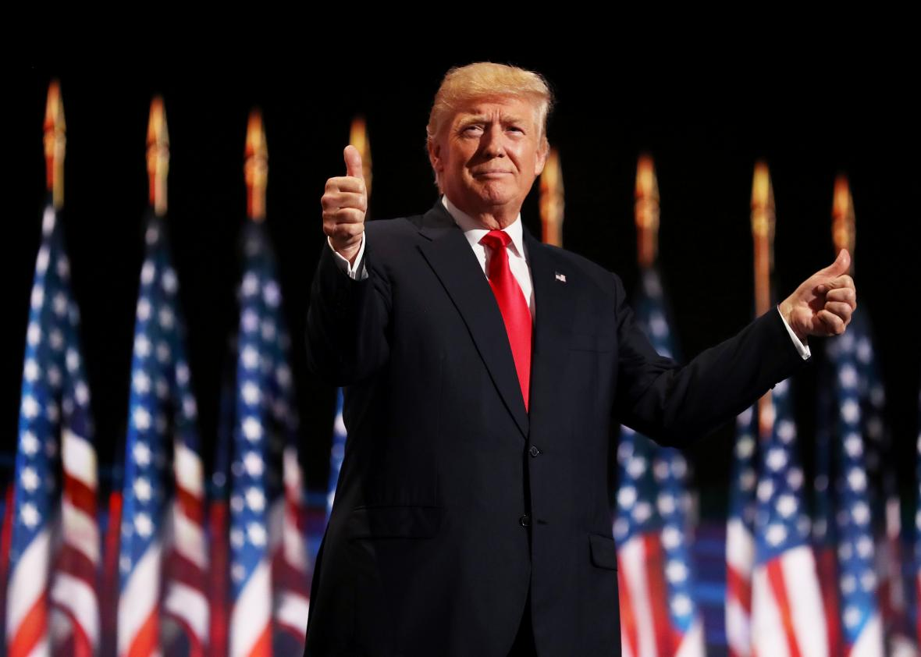
The President’s Power
Article II Section 2 of the Constitution gives the President authority to conduct the nation’s foreign relations. The President’s powers include:
Utilizing the Military, making Executive Agreements, Treaty-making, and implementing his Diplomatic power
4

Slide 5
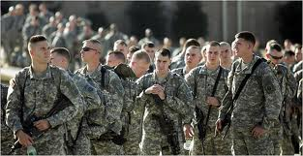
The President’s Powers
As Commander in Chief, the President can order the military into action. The War Powers Act states that the President has the authority to send troops anywhere in the world for 60 days, without Congressional approval. But only Congress can declare war.
5

Slide 6
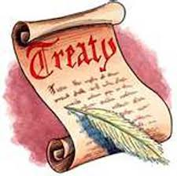
The President’s Powers
A treaty is a written agreement between two nations.
With the advice and consent of the Senate, the President has the power to make three different types of treaties:
Peace treaties- agreements to end war
Alliance treaties- agreements between countries to help each other (NATO)
Commercial treaties- agreements between countries to trade with one another (NAFTA)
6

Slide 7
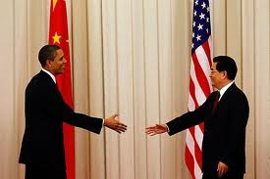
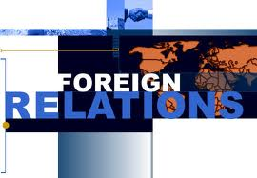
The President’s Powers
Aside from treaties, the President can make an executive agreement , which is a mutual understanding, with another country.
The President also has the power of diplomatic recognition; he may recognize or establish official relations with a foreign government.
Ambassadors are sent to these countries to build diplomacy and create relationships.
7

Slide 8
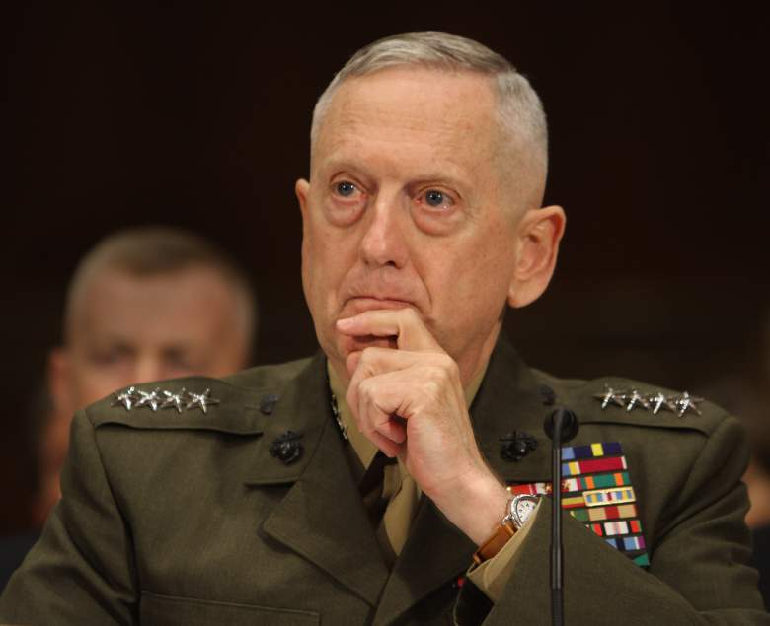
The Foreign Policy Bureaucracy “Agencies created to help the government do their jobs”
The President has help with foreign policy from his Cabinet Departments (Appointed by the President, approved by the Senate):
Secretary of State (State Department) – advises the President on foreign affairs and carries out U.S. foreign policy through the help of ambassadors and consuls
Secretary of Defense- (Defense Department) advises the President on troop movement, weapon development, etc.
Secretary of State
Mike Pompeo
Secretary of Defense
James Mattis
8

Slide 9
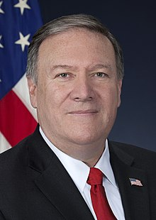
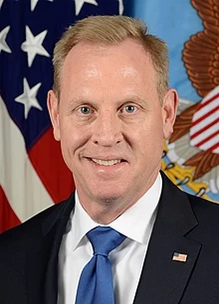
The Foreign Policy Bureaucracy “Agencies created to help the government do their jobs”
The President has help with foreign policy from his Cabinet Departments (Appointed by the President, approved by the Senate):
Secretary of State (State Department) – advises the President on foreign affairs and carries out U.S. foreign policy through the help of ambassadors and consuls
Secretary of Defense- (Defense Department) advises the President on troop movement, weapon development, etc.
Secretary of State
Mike Pompeo
(Acting) Secretary of Defense
Patrick Shanahan
9

Slide 10
The Foreign Policy and the People
American citizens can also impact foreign relations by promoting international peace through participation in organizations like the Peace Corps. They work to improve schools, health, business, technology, etc… in other countries.
10

Slide 11
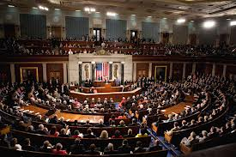
Congress’ Role in Foreign Policy
The Senate must approve all treaties between the U.S. and other countries by a two-thirds (2/3) vote
Only Congress has the power to declare war
Both houses of Congress must approve all expenditures of public funds (spending for national defense)
11

