Slide 1
Review FP Lesson 1
What is foreign policy?
Who can declare war?
What are the three kinds of treaties?
What is an executive agreement?
Who is our Secretary of State?
Who is our Secretary of Defense?

Slide 2
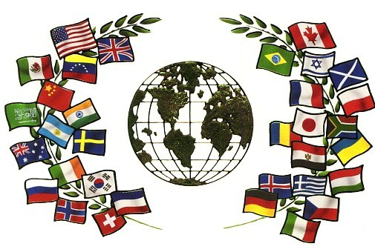
FP Lesson 2 – “Working for Peace”

Slide 3
Diplomacy and Alliances
Diplomacy is an important part of foreign policy.
The process of conducting relations between countries is called diplomacy.
- A Diplomat is an official representing a country abroad
Diplomacy is used to prevent war, negotiate an end to conflicts, solve problems, and establish communication between countries
International relations is the study of relationships among different countries.

Slide 4
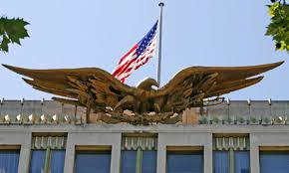
Diplomacy and Alliances
Ambassadors are the highest ranking diplomat representing a government in a foreign country
An embassy is the official residence of an ambassador in a foreign country

Slide 5
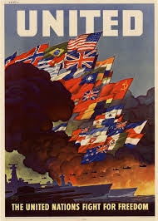
Diplomacy and Alliances
An alliance is an agreement in which two or more countries commit to helping each other for defense, economic, scientific, or other reasons.
- two countries that have friendly relations are allies

Slide 6
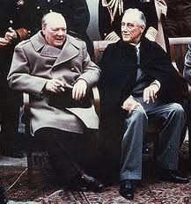
Diplomacy and Alliances
Presidents use diplomacy to improve relationships with foreign countries.
One example is called a summit - a meeting between the leaders of two or more countries to discuss issues
President Franklin D. Roosevelt and British Prime Minister Winston Churchill had a secret summit to discuss an alliance during World War II

Slide 7
Diplomacy and Alliances
One of the main goals of U.S. foreign policy is to promote national security. The U.S. forms alliances for defense as a way to promote peace.
International Organizations Tutorial
http://www.floridastudents.org/BenchmarksList/PreviewStandard?benchmarkLists=3218&subjectAreaId=32&gradeLevelGroupId=6&CourseID=13312#6|6|13312|3218

Slide 8
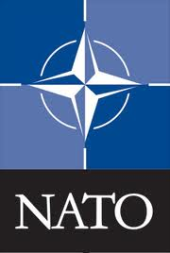
Diplomacy and Alliances
In 1948, the U.S. and most countries in Latin America formed the Organization of American States (OAS). The goal of OAS is mutual defense and the peaceful settlement disputes among member countries.
NATO (North Atlantic Treaty Organization) is perhaps the most important security alliance formed by the U.S. and its allies. In 1949, they wanted to establish a united front against aggression by the Soviet Union and its communist allies. Now countries aid the organization in military expenses and peacekeeping operations
https://www.youtube.com/watch?v=JGc3v56_ZZY
What is the purpose of organizations like this?
(Regional cooperation)

Slide 9
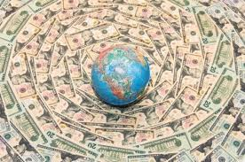
Forms of Foreign Aid
Foreign aid is any government program that provides economic or military assistance to another country. This is used as a diplomatic aid.
Many international organizations and individual countries provide foreign aid.
The U.S. first gave large amounts of foreign aid during and after World War II.

Slide 10
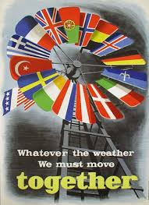
Forms of Foreign Aid
After WWII, the US helped rebuild Europe using about $13 billion ($130 billion today)
This was an act known as the Marshall Plan
Helped build and create better relations with rival countries after the war

Slide 11
Major International Organizations
Non-Governmental Organizations/ International Non-Governmental Organizations (NGO/INGO) Private organizations that pursue activities to:
relieve suffering
promote the interests of the poor
protect the environment
provide basic social services
undertake community development.
These operate independently from any government and maintain their non-governmental status by excluding government representatives from membership in the organization.

Slide 12
Major International Organizations
International Red Cross/ Red Crescent-an international humanitarian movement with approximately 97 million volunteers, members and staff worldwide which was founded to protect human life and health.
United Nations Children’s Fund (UNICEF)- a United Nations Program headquartered in New York City, that provides long-term humanitarian and developmental assistance to children and mothers in developing countries.

Slide 13
Foreign Policy and Foreign Trade
Foreign competition has led the U.S. to seek ways to improve its position in the global economy.
The U.S. has joined a few international efforts that support trade and promote peaceful interaction among nations:
The U.S. signed the North American Free Trade Agreement (NAFTA) , which allows free trade among the U.S., Canada, and Mexico. We have since modified that agreement and now are operating under the USMCA (United State, Mexico, Canada trade agreement)
WTO (World Trade Organization)- Supervises international trade

Slide 14
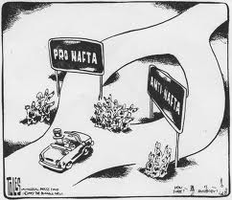
Organizations that Impact Foreign Trade
WTO and NAFTA are expected to help American consumers and producers in the long run. But not everyone likes the idea….
Opponents fear the U.S. will relocate factories and other manufacturing operations to other countries for cheaper labor and material
Supporters say it will help the country gain greater access to foreign markets and lead to increased growth in the U.S. economy.

Slide 15
Talk to your shoulder partner!
Based on what we’ve talked about today – which of the following do you feel is most important in conducting foreign policy and why?
Diplomacy
Alliances
Foreign Aid
Foreign Trade
Be prepared to justify your thoughts!

