Slide 1
“Elections”

Slide 2
Primary Elections
Primary elections occur first and help narrow the field of candidates for each Political Party.
Open Primary – an election in which voters need not declare their party preference
Closed Primary – only declared members of a party are allowed to vote for that party’s nominees. We have this in Florida!!!

Slide 3
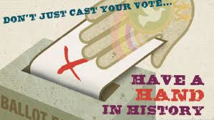
General Elections
General Election – voters choose leaders for various offices such as president (kind of….), Congress members, and state and local positions.
General elections always take place on the first Tuesday after the first Monday in November.
Presidential elections occur every four years in even numbered years. (The next presidential election will be in 2020.)
In all races except the Presidential race, the candidate who wins the majority of the popular vote is elected into the office.

Slide 4
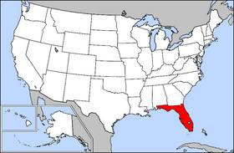
Elections
Elections are held at three levels: federal, state and local.
** States oversee their own elections!

Slide 5
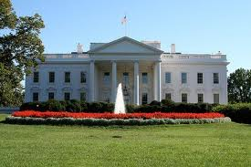
Presidential Election

Slide 6
The Electoral College
There was much debate over who should select the President when the Constitution was being written ---- The compromise was to have the Legislatures in each state choose a slate of Presidential Electors who would then pick the president.
Today, voters have a bigger say than we did in the beginning. We vote on election day and our vote tells the electors “how we want them to vote”…
The Electoral College is a Winner Take All System!!!!

Slide 7
Presidential Election Process
Nomination - the process in which political parties select and offer candidates for public office
Presidential hopefuls start campaigning a year or more before the election.
So much campaigning goes on during the primary elections that the conventions are now used to “kick off” the campaign and rally party members.

Slide 8
Campaign
Campaign – the process in which candidates are competing for public office using media, debates, and speeches.
Candidates travel to different states to give speeches, meet with state and local leaders and face their opponents in debates.

Slide 9
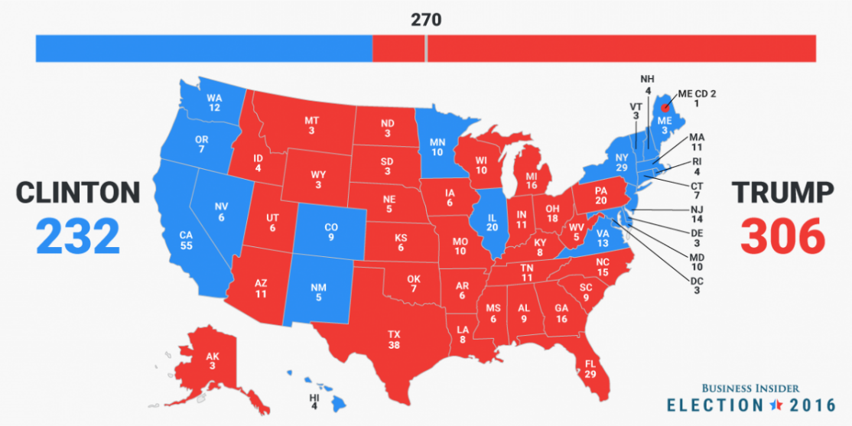
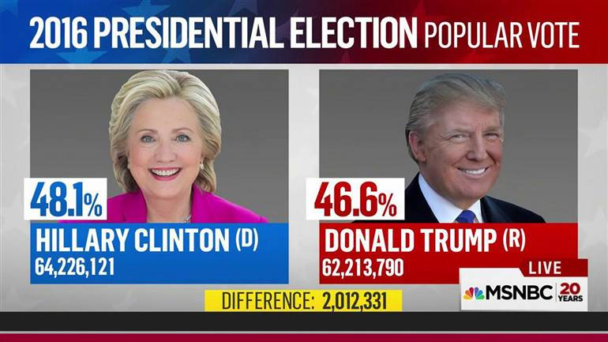
The Electoral College
The Electoral College - the process by which a presidential candidate is elected to office.
Presidents are not chosen by direct popular vote, but by the Electoral College.

Slide 10
The Vote and Electoral College
The people vote for the candidate that they would like to see win the Presidency. But the President is not chosen directly by the people…
The President is actually chosen by the number of electoral votes he/she earns.
Every state has one elector per U.S. Senator and Representative in that state. The number of electors per state = the number of Senators + the number of Representatives for that state.
PLUS Washington, D.C. gets three electoral votes
The fewest number of Electors a State can have is 3 – Why???

Slide 11
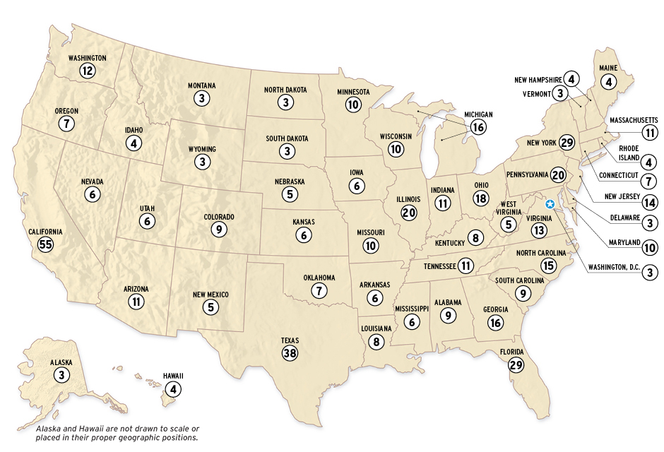
The Vote and Electoral College
There is a total of 538 Electoral Votes in the U.S.
435 House Members + 100 Senators + 3 DC = 538
The State of Florida currently has 29 electors, which means we get 29 electoral votes during the Presidential Election (27 House Members + 2 Senators = 29)

Slide 12
The Vote and Electoral College
The candidate who receives the majority of the electoral votes wins the election - 270 or more of the 538 electoral votes.

Slide 13
Bush v. Gore - 2000
Your vote does count! But it doesn’t always mean the “people decide”
In the 2000 election Al Gore had 500,000 more votes than George Bush but still lost.
George Bush had more Electoral Votes - 271-266. George Bush won and became the 43rd President.
Al Gore wanted to do a hand recount, but the Courts ruled that using different standards for counting votes in different counties violated the Constitution.

Slide 14
Winner Take All System
The Candidate who wins the most “popular votes” in a state most often wins ALL of the Electoral Votes for that state. (all states except for Nebraska and Maine)…..This is what allows a candidate to lose the Popular Vote yet still win the Presidency. This is rare, but has happened, most recently in the 2016 election.

Slide 15
The Electoral College Map Today

