Slide 1
Foreign Policy Review
1. What is Foreign policy?
2. What are the goals of U.S. Foreign Policy?
3. What is Diplomacy?
4. What are some of the international organizations that we discussed yesterday?

Slide 2
FP Lesson 3 – “ The United Nations”

Slide 3
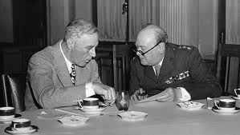
The United Nations
During World War II, President Franklin D. Roosevelt met with British Prime Minister Winston Churchill and agreed that all people should have the right to choose their own government and to live free from war, fear and want.

Slide 4
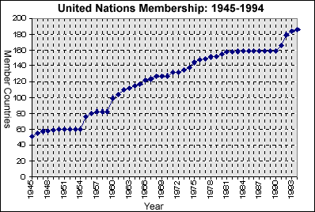
The United Nations
In 1945, representatives from 50 countries met to form the United Nations, an organization that promotes peaceful coexistence and worldwide cooperation. Now there are 193 member nations

Slide 7
The United Nations
The UN headquarters is located in New York City and has 5 main divisions:
General Assembly- discuss, debate and recommend solutions to problems
Security Council- responsible for peacekeeping
There are also 5 permanent countries that are a part of the Security Council of the UN: China, France, Russian Federation, the United Kingdom, and the United States.
Economic and Social Council- dedicated to improving the lives of the worlds people
Trusteeship Council- help various non-self governing colonies or areas
Secretariat- manages the day-to-day activities of the UN and provides services to other UN divisions

Slide 8
International Court of Justice- arm of the UN, handles international legal disputes (also known as the World Court)
https://www.youtube.com/watch?v=QoIafzc0k74

Slide 9
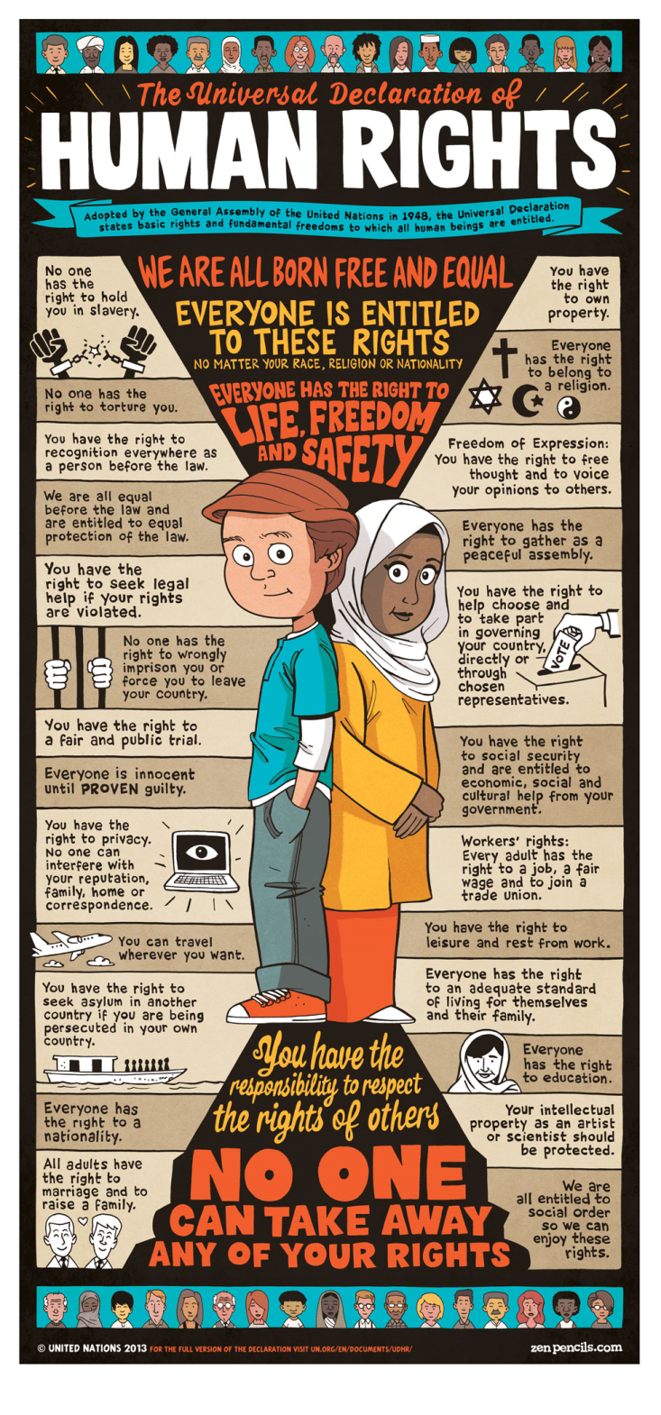
The United Nations
The Universal Declaration of Human Rights was adopted by the United Nations, which details the rights to which all human beings are inherently entitled.
For example, you are innocent until proven guilty, no torture, the right to privacy, etc.

Slide 12
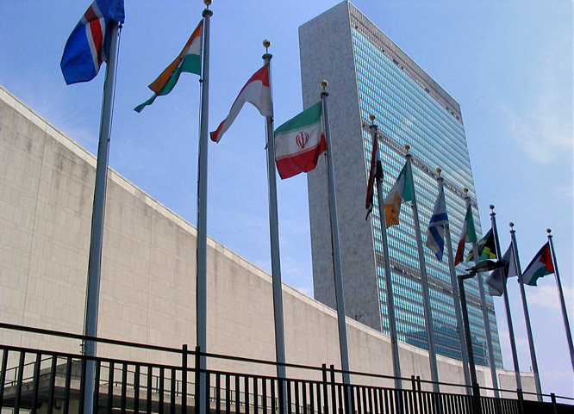
The UN in the Modern World
The United Nations provides a place where the world’s countries can express their views about problems that threaten peace.
At the UN Headquarters in New York, the flags fly in alphabetical order – Afghanistan to Zimbabwe

Slide 13
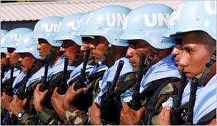
The UN in the Modern World
Disputes between countries cannot always be settled through diplomacy, therefore the UN has organized a peacekeeping force.
The peacekeepers monitor conflicts, oversee territorial agreements and cease-fires, and help stabilize political situations.
The World Court handles international legal disputes such as boundary disputes and debt payments.

Slide 14
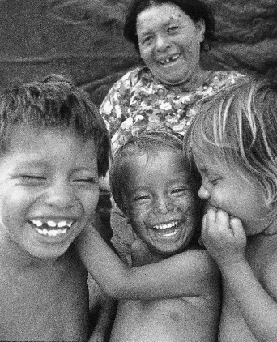
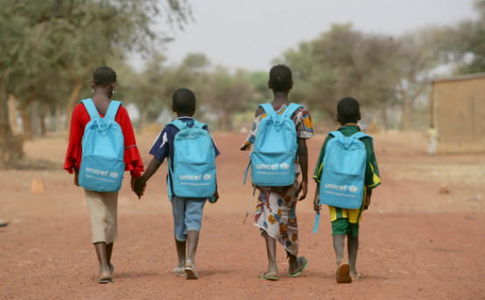
The UN in the Modern World
The UN has made a huge impact in our modern world.
UNICEF (United National Children’s Fund) - an agency of the United Nations responsible for programs to aid education and the health of children and mothers in developing countries.

Slide 15
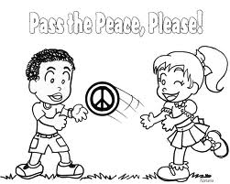
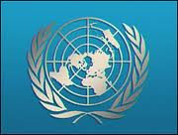
The UN in the Modern World
The UN has encountered some criticism:
Opponents believe the U.S. pays too much money for the organization’s operations and powerful nations can be outvoted in the General Assembly
Supporters believe the UN is the world’s best hope for peace.

Slide 16
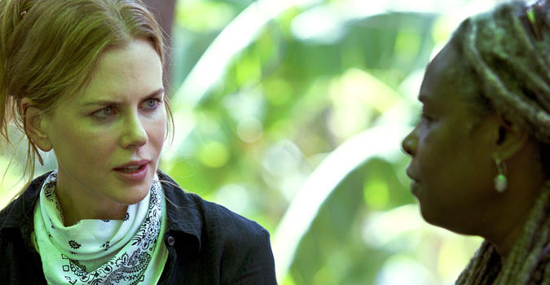
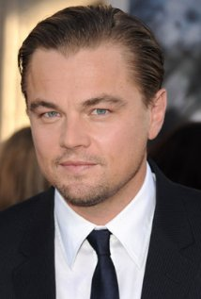
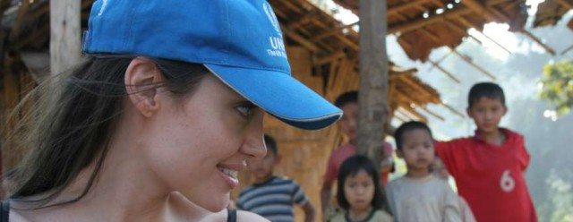
United Nations Goodwill Ambassadors
Nicole Kidman United Nation’s
Women’s Goodwill Ambassador
Emma Watson
United Nation’s Women’s
Goodwill Ambassador
Leonardo DiCaprio
United Nation’s
Climate Ambassador
Angelina Jolie United Nation’s
Refugee Ambassador

Slide 17
UN Sustainable Development Goals
Goals to improve the health and well-being of all peoples, animals, and the environment. All countries in the UN will work to achieve these goals by 2030 by creating policy and providing financial aid and volunteer services.

