Slide 1
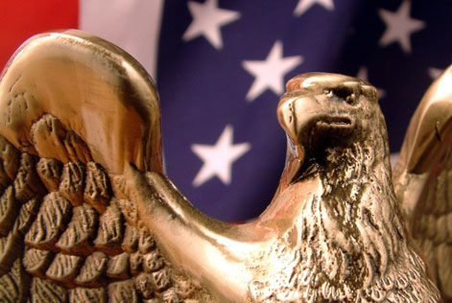
Civics In Our Lives

Slide 2
Why do we study“Civics”?
“Civics” is the study of what it means to be a citizen.
Civics is the study of our rights and duties as citizens.
A citizen is a legally recognized member of a community.

Slide 3
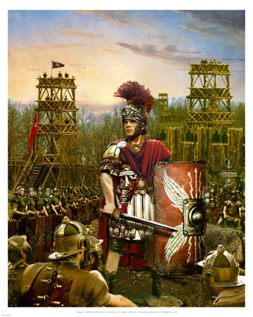
Roman Citizenship
The idea of “citizen” has changed over time.
Romans used the term “citizen” to make distinctions about their people.
Citizens were born in Rome
Non-citizens came from other territories.

Slide 4
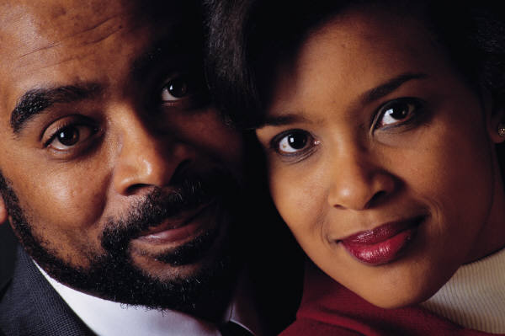
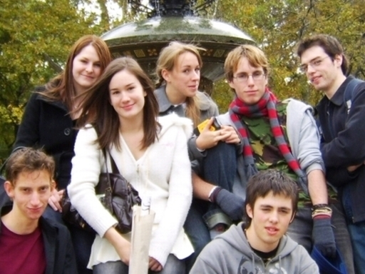
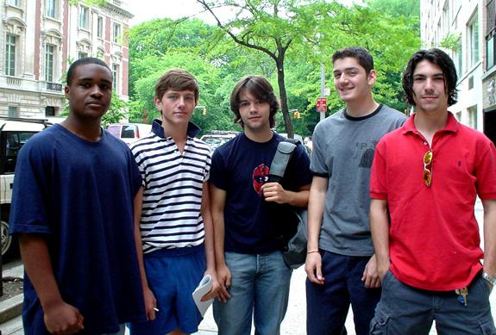
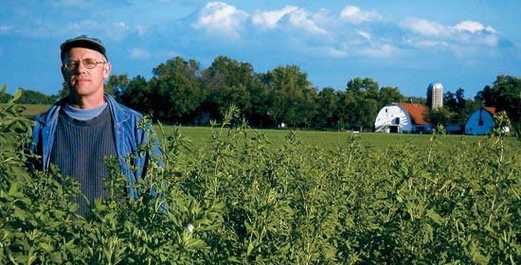
Today, citizens have rights and responsibilities that differ from country to country.

Slide 5
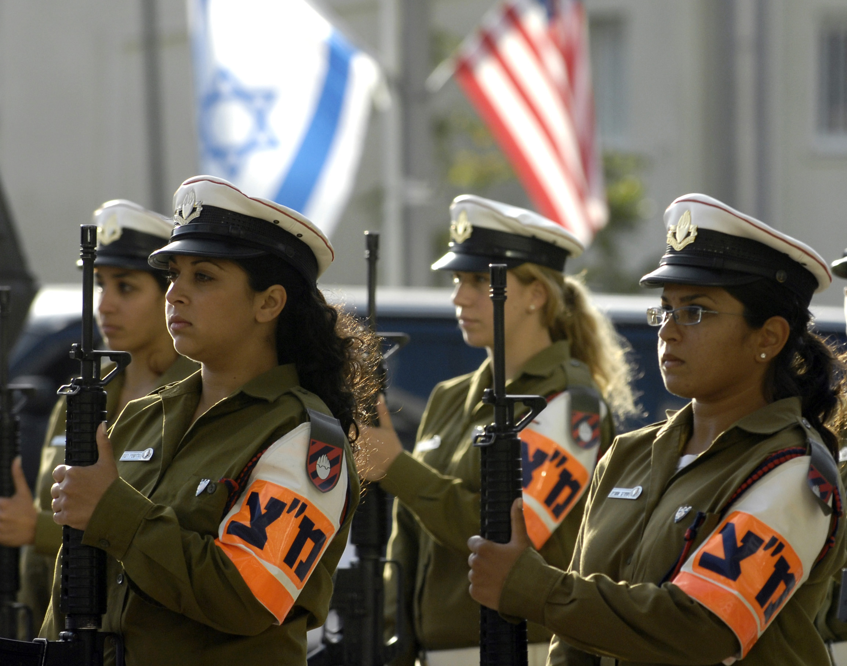
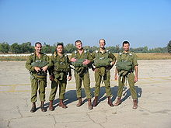
Citizens
The rights and duties of citizens depend on their country’s government.
For example, Israel requires all it’s citizens (men and women) to join the military.

Slide 6
The Citizen & Government
A government is the organizations, institutions, and individuals who exercise political authority over a group of people.

Slide 7
What is “government”?
“Government” is the ruling authority for a community.
It has the power to make laws, enforce laws, and make decisions for the community.
Authority (the power to direct the actions of people)

Slide 8
The Citizen & Government
Citizens should be productive and active members of society.
Good Citizens should be loyal to their government.
Each citizen also is entitled to protection by and from that government.
This is the “Social Contract” that people have with their government – governments exist to protect the rights of the people and the people should respect the decisions of government.

Slide 9
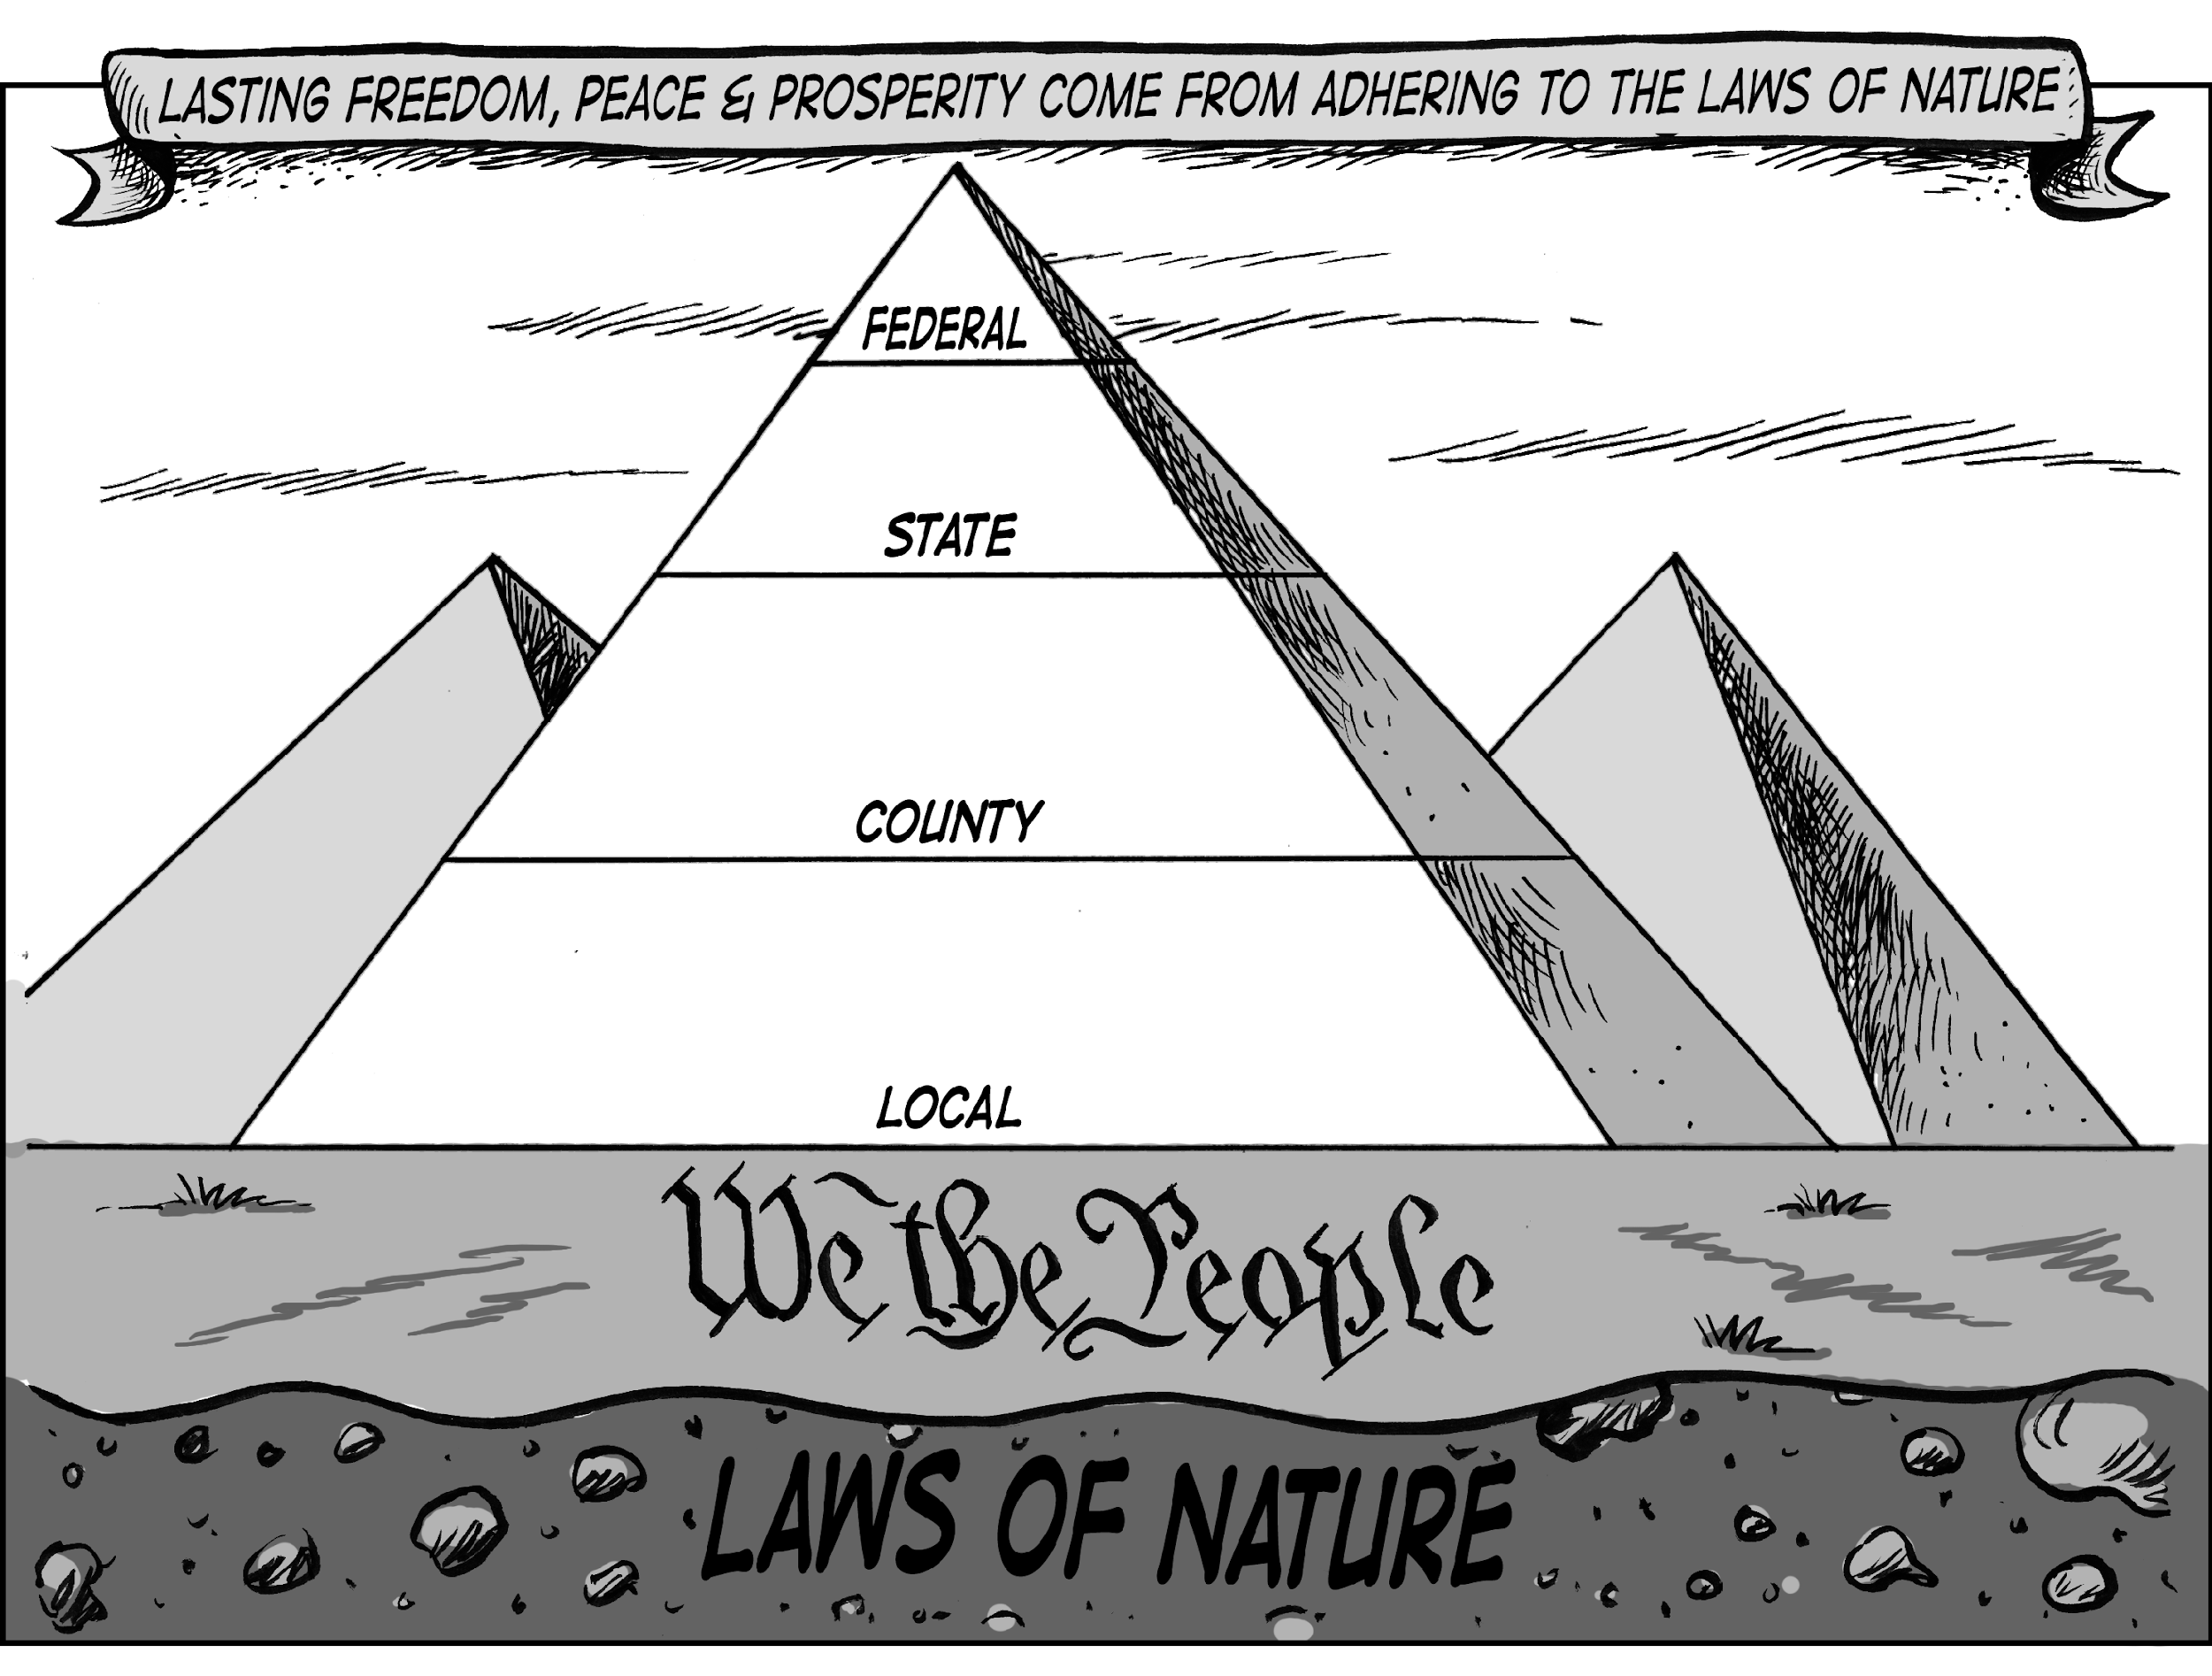
The Citizen & Government
Americans are citizens of their local communities.
In America, you are a citizen of BOTH your country and your state.
This is called a federal system of government where the power is shared between the states and national governments.
As opposed to a confederal system (No Central Power)

Slide 10
Citizens’ “Training”
In order to be a good citizen, you have to have “training”
You need to understand:
The purpose of government
How the government works at each level
Local – closest to the people
State – 50 in the US
Federal – highest level
The highest level of government is the federal
The level closest to the people is the local
How the US Economic System works

Slide 11
Levels of Government

Slide 12
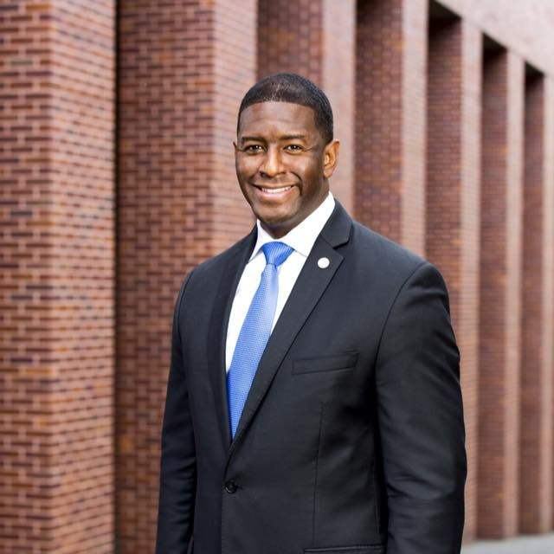
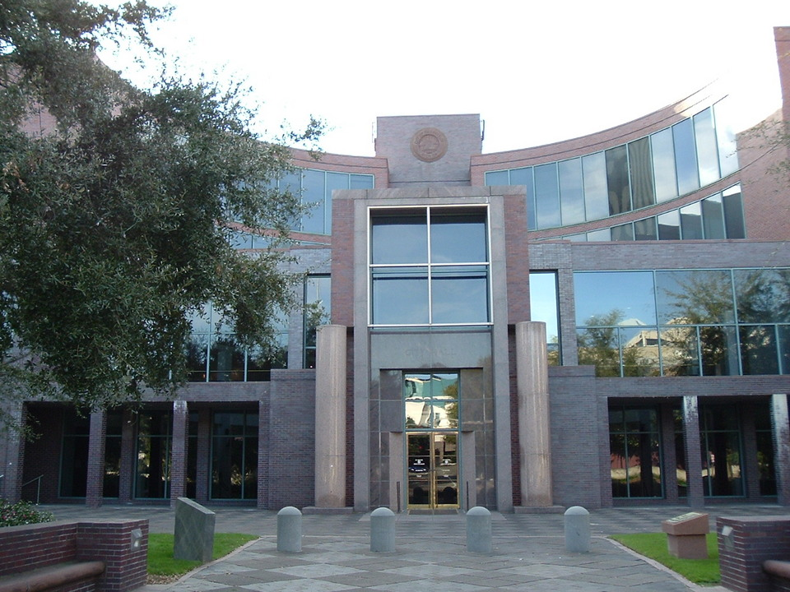
“Local” government (Tallahassee / Leon County) Closest to the people and provides most services - discuss services provided by this level of government……..

Slide 13
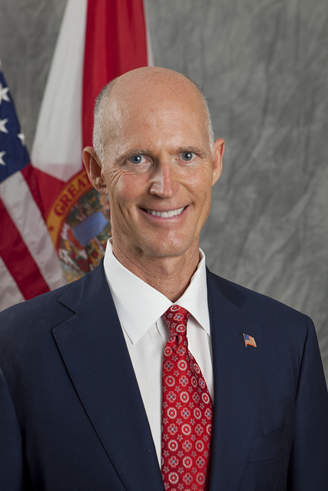
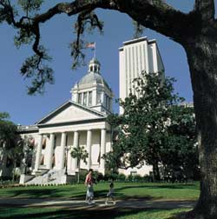
“State” government (Florida) - discuss services provided by this level of government

Slide 14
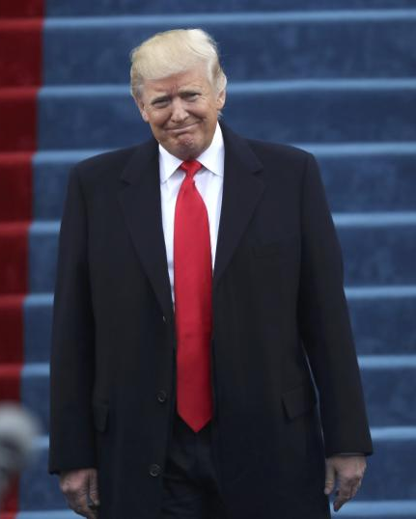
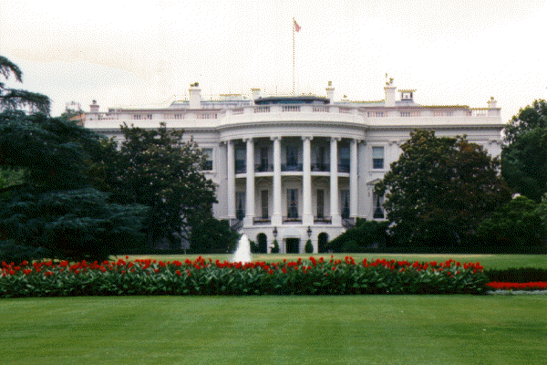
“Federal” government (United States of America) Highest level – others must follow all from Federal - discuss services provided by this level of government

Slide 15
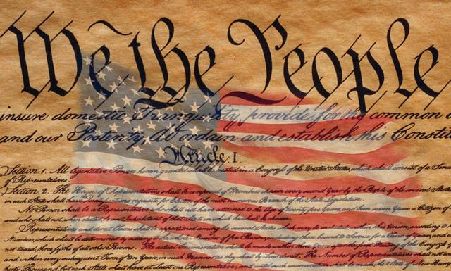
American Values
The United States has inspired many nations because of it’s basic values.
1 – equality
2 – liberty
3 - justice
As American citizens, we are all guaranteed certain rights and freedoms. Many of these based from ideas in our US Constitution -- which seeks to protect these values.

Slide 16
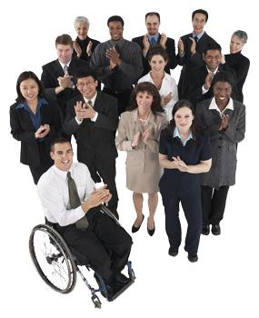
American Values
Equality – means that each citizen has the right to enjoy the same freedoms guaranteed to all.
We have the right to seek employment, get an education, etc.

Slide 17
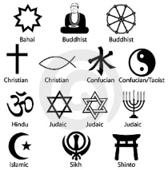
American Values
Liberty– grants the citizens freedom to make choices in their daily lives.
We have the right to choose our religion, where we live, who we marry, etc.

Slide 18
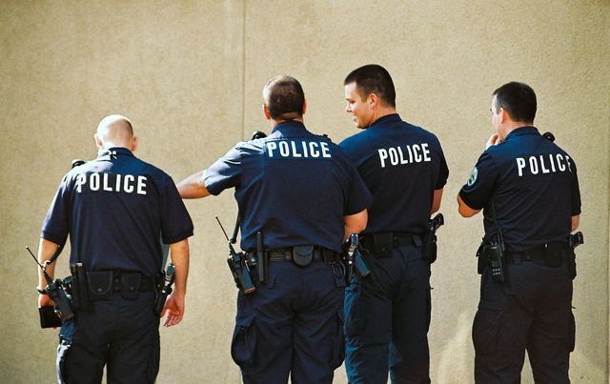
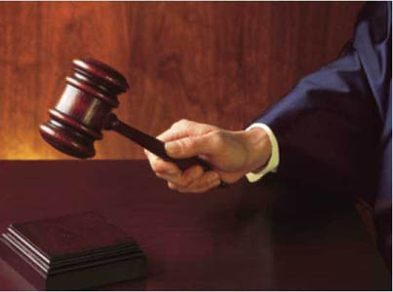
American Values
Justice– means that our government make sure all is fair and right – it provides protection (police) from our rights being violated. If someone infringes on your rights, the courts can punish them.
Doing the “right thing” means fulfilling your “civic duty”.

Slide 19
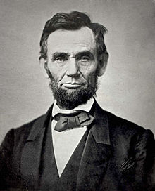
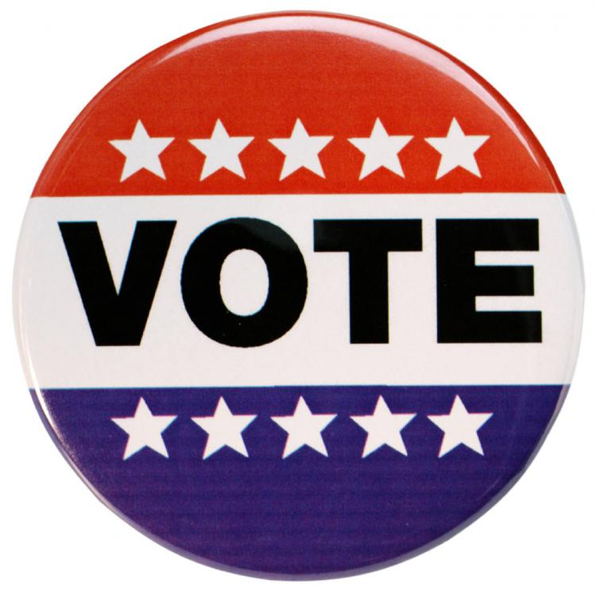
Qualities of a Good Citizen
Abraham Lincoln once said that We cannot have “a government of the people, by the people, for the people” unless people participate.
There are several ways that citizens can get involved.
Voting in Elections
Most important responsibility!
Choose representatives who are best
qualified!
Expressing Your Opinion
- Let your voice be heard!
Getting involved in Government

Slide 20
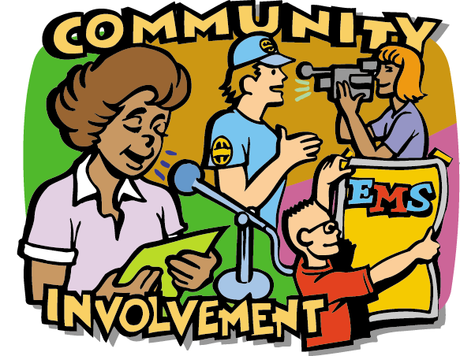
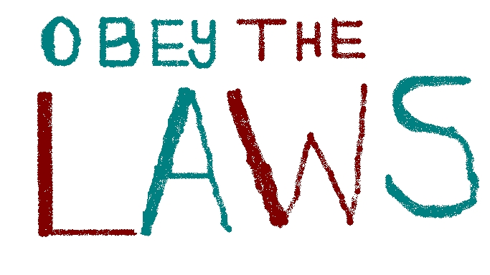
Qualities of a Good Citizen
Top Ten Characteristics of a Good Citizen
Responsible family member
Respect and obey the law
Respect the rights and property of others
Are loyal to and proud of their country
Take part in and improve the community
Take an active part in their government
Use natural resources wisely
Are informed on key issues
Believe in equal opportunities
Respect individual differences, points of views and ways of life that are different from their own.

