Slide 1
The Duties and Responsibilities of Citizens

Slide 2
THE DUTIES OF A CITIZEN
A duty (also called an obligation) is something that a citizen is required to do, by law.
Examples of duties/obligations are: obeying laws, paying taxes, defending the nation and serving on juries.

Slide 3
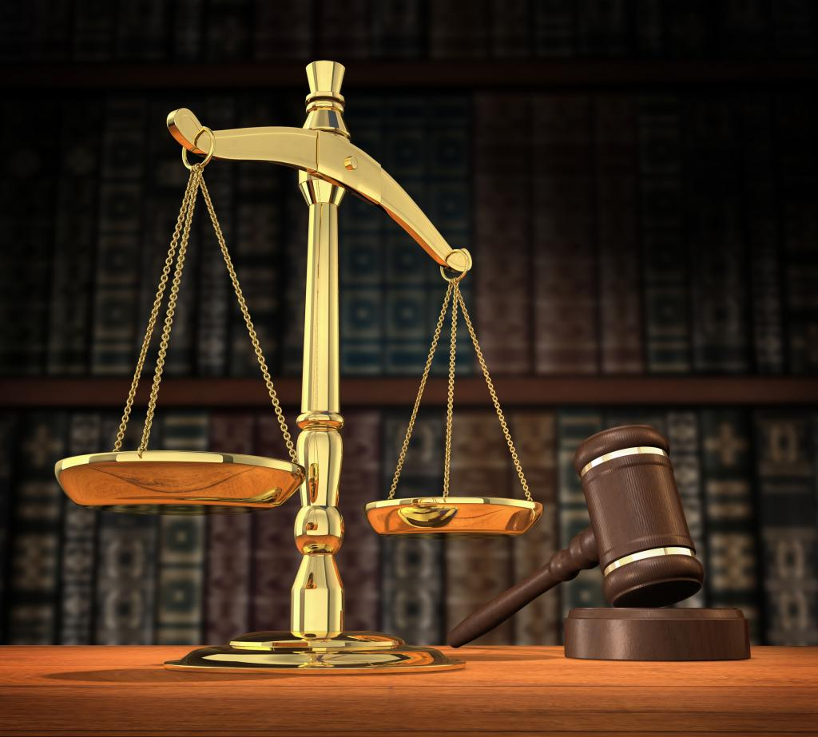
1. Obeying the Law
Rule of Law: Everyone is under the law.
To obey the law, you must know the law.
Without laws our society would quickly collapse.

Slide 4
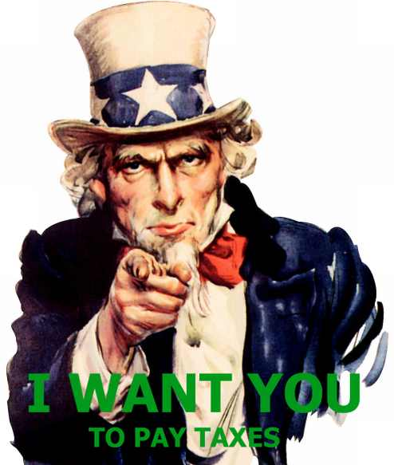
2. Paying Taxes
Taxes pay for services like firefighters and police, they build roads, and also public schools.
Tax money also pays for national defense and military.

Slide 5
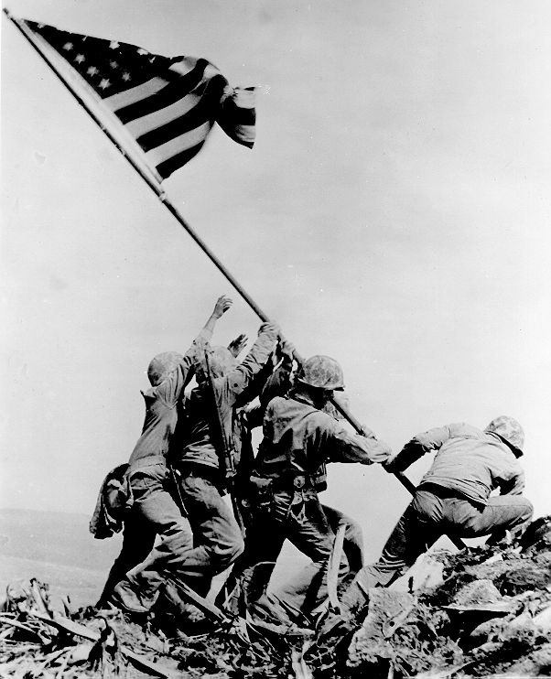
3. Serving in the Armed Forces
In times of war, Congress can declare a draft and require men of certain ages to serve in the military.
The last draft was called in 1973 during the Vietnam War.
The military is now using only volunteers, however 18 year old men must register for the Selective Service in case a draft is called.
Rationing is used in wartime to conserve supplies needed for the troops.

Slide 6
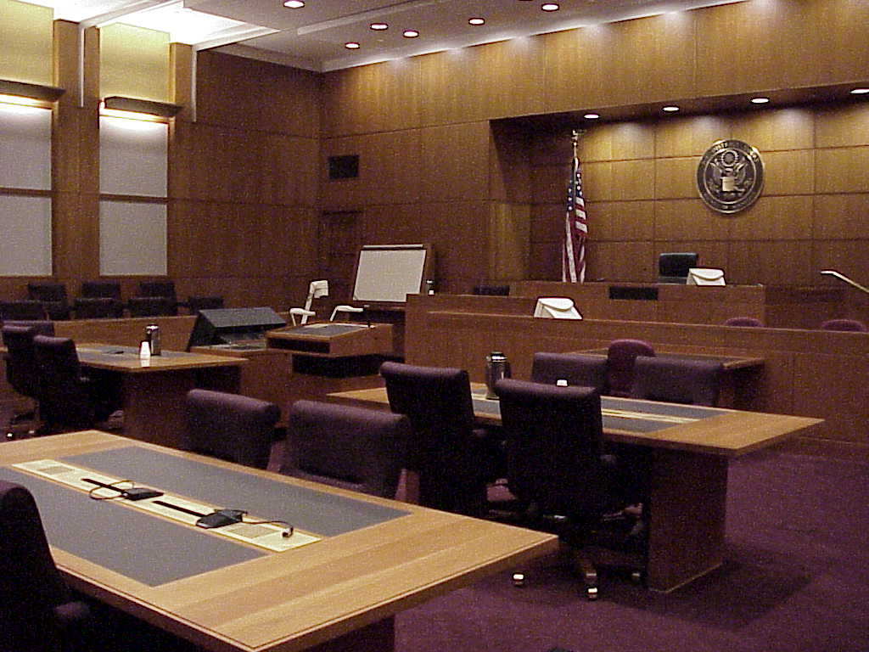
4. Appearing in Court
Jury Duty is the mandatory action of serving on a jury for a court case.
Jury Duty often requires sacrifices of work for a while with very little pay.
Jury Duty is necessary so that we can have a trial by peers.

Slide 7
THE RESPONSIBILITIES OF A CITIZEN
Citizens also have responsibilities – these are things that they should do but are not required by law.
Examples of responsibilities are: voting, attending civic meetings, petitioning the government, and running for office.

Slide 8
“If you don’t vote, don’t complain about the results.”
Many people gave their lives so we can vote, making it an honor and responsibility.
Voting tells leaders what we like… and don’t like.
Our government is based on the consent of the governed.
1. Voting

Slide 9
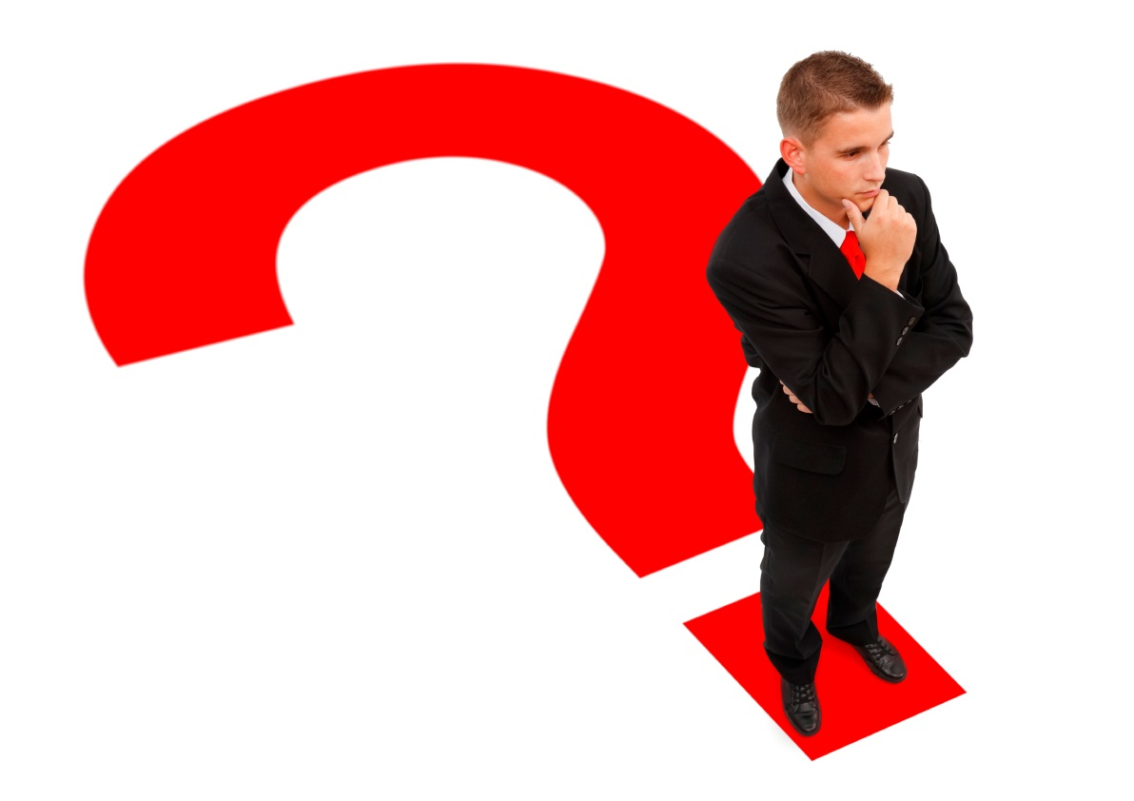
2. Being Informed
To vote wisely, you must be well informed of candidates, current events, key issues, and the current politics.

Slide 10
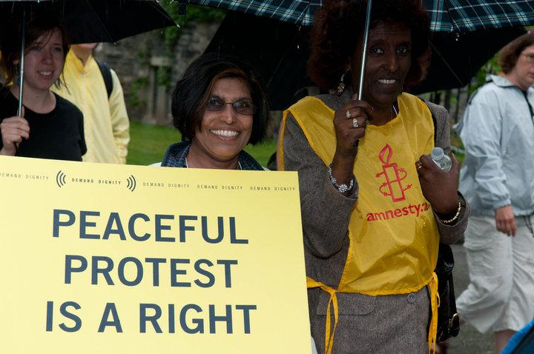
3. Taking Part
in Government
Taking part is as easy as voting and joining a political party or attending civic meetings.
We also need leaders who will run for office.
The quality of government depends on the people in it.

Slide 11
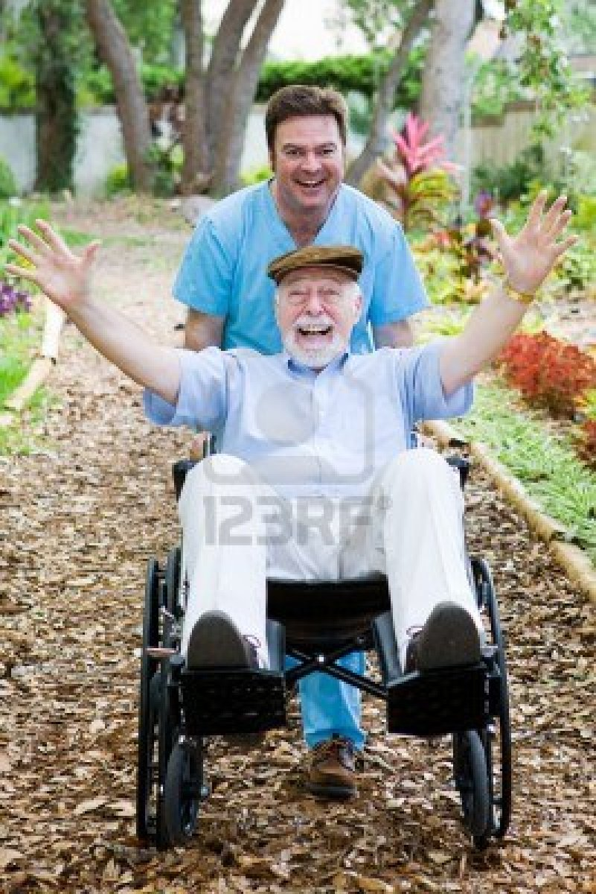
4. Helping Your Community
One of your most important responsibilities is taking part in community service to help others in need in your community.
Volunteering is a huge part of being an active citizen in the community.

Slide 12
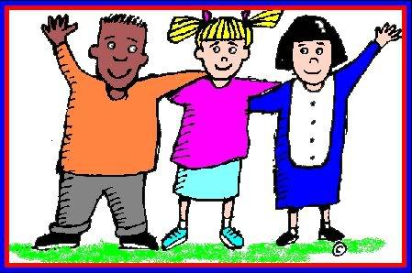
5. Respecting and Protecting Others’ Rights
You should know your rights.
The rights you have belong to those around you too.
You have the responsibility to make sure your rights and others’ rights are protected.

Slide 13
Protecting the Common Good
Beliefs or actions that are a benefit to the larger community rather than to the individual.
By fulfilling your obligations and responsibilities as a citizen, you are protecting the common good (well being of all citizens)
It is your Civic Duty to “do the right” thing…………..

