Slide 1
Chapter Three (Section One) “Being An American”

Slide 2
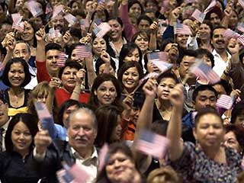
Welcome to America!!

Slide 3
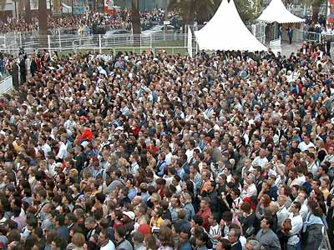
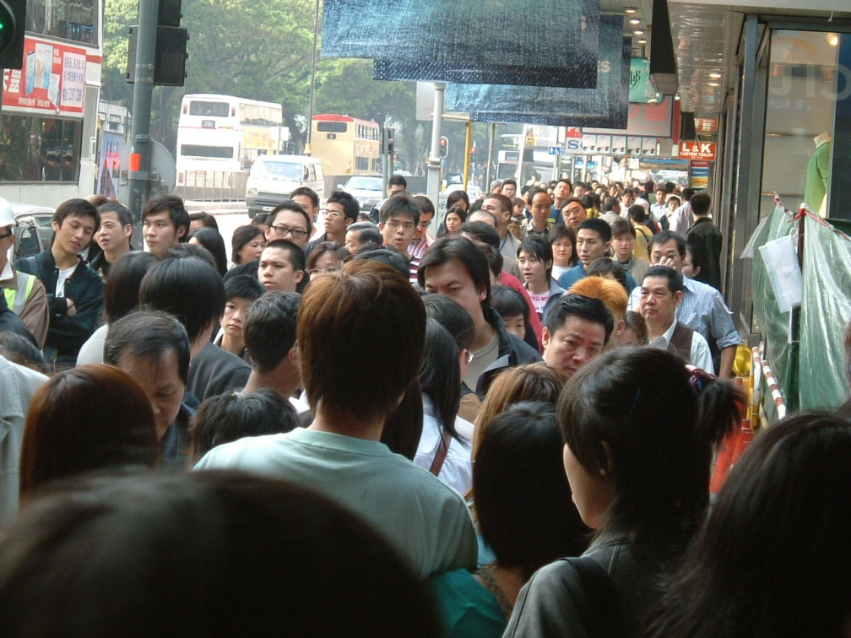
Over 314 Million Strong!!!

Slide 4
The Census
Many countries conduct a census which is an official, periodic counting of the population.
In the United States, a census is conducted every 10 years.

Slide 5
The Census
A census determines each state’s population.
That information is used to apportion representation to the House of Representatives. (determine how many representatives each state gets).
Tracks where people are living and where areas are growing or shrinking.
Collects demographics, that is human characteristics such as: religion, ethnicity, number of children, even number of pets!
Census information is public and can be found at www.census.gov

Slide 6
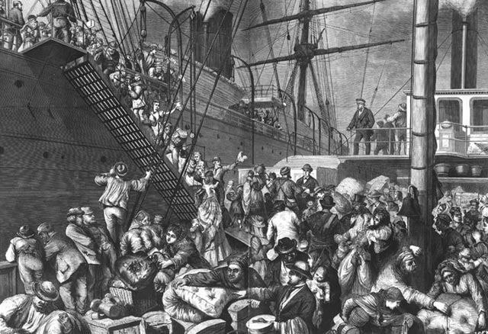
Population Growth
A country’s population can grow in three main ways:
1 - Natural Increase
Birthrate
Deathrate
2 - Adding Territory
3 - Immigration
Since 1820, more than 60 million immigrants have come from all over the world to call the US home.

Slide 7
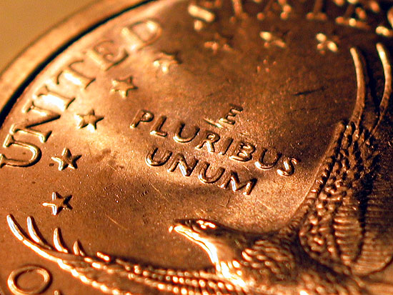
E Pluribus Unum
As read on all US coins, E Pluribus Unum, Latin for “out of many, one” embodies the idea that our country, though diverse and ever-changing, is still one unified nation.
These 60 million immigrants make up our rich, diverse population today…

Slide 8
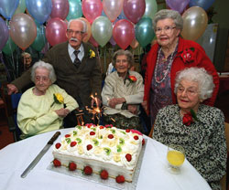
Population Changes
Our population is ever-changing due to the following factors:
Changing Households (divorce, marriage, fewer kids)
Changing Women’s Roles (more women work today)
An Older Population (people are healthier than ever… in 2000, there were 65,000 Centenarians!
A More Diverse Population (many Americans today have a mixed heritage)
Where people live (rural to urban setting……farm to cities and suburbs) – Migration (movement of people)

